Slide 1
Cornerstone City Church Peninsula Plus Community Hoo Are Ya
20-08-2023

Slide 2
I reach Up High
CCLI Song # 1075387
Judy Bailey
© 1993 Song Solutions Daybreak (Admin. by Song Solutions www.songsolutions.org)
For use solely with the SongSelect® Terms of Use. All rights reserved. www.ccli.com
CCLI Licence No. 33265

Slide 3
1/3
I reach up high I touch the ground
I stomp my feet and turn around
I've got to (woo woo) Praise the Lord
I jump and dance with all my might
I might look funny but that's alright
I've got to (woo woo)
Praise my Lord

Slide 4
2/3
I'll do anything just for my God
'Cause He's done ev'rything for me
It doesn't matter who is looking on
Jesus is the person that I want to please

Slide 5
3/3
May my whole life be a song of praise
To worship God in ev'ry way
In this song the actions praise His name
I want my actions ev'ry day to do the same

Slide 6
House Of The Lord
CCLI Song # 7168995
© 2020 Phil Wickham MusicSimply Global SongsBe Essential SongsCashagamble Jet Music
For use solely with the SongSelect® Terms of Use. All rights reserved. www.ccli.com
Note: Reproduction of this sheet music requires a CCLI Music Reproduction Licence. Please report all copies.
CCLI Licence No. 33265

Slide 7
1/5
We worship the God who was
We worship the God who is
We worship the God who evermore will be
He opened the prison doors
He parted the raging sea
My God He holds the victory yeah

Slide 8
2/5
There’s joy in the house of the Lord
There’s joy in the house of the Lord today
And we won’t be quiet
We shout out Your praise

Slide 9
3/5
There’s joy in the house of the Lord
Our God is surely in this place
And we won’t be quiet
We shout out Your praise

Slide 10
4/5
We sing to the God who heals
We sing to the God who saves
We sing to the God who always makes a way
'Cause He hung up on that cross
Then He rose up from that grave
My God’s still rolling stones away

Slide 11
5/5
We were the beggars
Now we’re royalty
We were the prisoners
Now we’re running free
We are forgiven accepted
Redeemed by His grace
Let the house of the Lord sing praise

Slide 12


Slide 13
Battle Belongs
CCLI Song # 7148126
Brian Johnson | Phil Wickham
© Phil Wickham Music (Admin. by / Small Stone Media BV, Holland (Admin. in the UK/Eire by Song Solutions www.songsolutions.org))
Simply Global Songs (Admin. by / Small Stone Media BV, Holland (Admin. in the UK/Eire by Song Solutions www.songsolutions.org))
Bethel Music Publishing (Admin. by Song Solutions)
For use solely with the SongSelect® Terms of Use. All rights reserved. www.ccli.com
CCLI Licence No. 33265

Slide 14
1/4
When all I see is the battle
You see my victory
When all I see is a mountain
You see a mountain moved
And as I walk through the shadow
Your love surrounds me
There's nothing to fear now
For I am safe with You

Slide 15
2/4
So, when I fight, I'll fight on my knees
With my hands lifted high
O God the battle belongs to You
And every fear I lay at Your feet
I'll sing through the night
O God the battle belongs to You

Slide 16
3/4
And if You are for me
Who can be against me
For Jesus there's nothing
Impossible for You
When all I see are the ashes
You see the beauty
When all I see is a cross
God, You see the empty tomb

Slide 17
4/4
Almighty Fortress You go before us
Nothing can stand against
The power of our God
You shine in the shadows
You win every battle
Nothing can stand against
The power of our God

Slide 19
Holy Forever
CCLI Song # 7201044
Brian Johnson | Chris Tomlin | Jason Ingram | Jenn Johnson | Phil Wickham
© Phil Wickham Music (Admin. by / Small Stone Media BV, Holland (Admin. in the UK/Eire by Song Solutions www.songsolutions.org))
Simply Global Songs (Admin. by / Small Stone Media BV, Holland (Admin. in the UK/Eire by Song Solutions www.songsolutions.org))
Capitol CMG Paragon (Admin. by Capitol CMG Publishing)
S. D. G. Publishing (Admin. by Capitol CMG Publishing)
Be Essential Songs (Admin. by Essential Music Publishing LLC)
My Magnolia Music (Admin. by Essential Music Publishing LLC)
Bethel Music Publishing (Admin. by Song Solutions)
Brian and Jenn Publishing (Admin. by Song Solutions)
For use solely with the SongSelect® Terms of Use. All rights reserved. www.ccli.com
CCLI Licence No. 33265

Slide 20
1/10
A thousand generations falling down in worship
To sing the song of ages to the Lamb
And all who've gone before us
And all who will believe
Will sing the song of ages to the Lamb

Slide 21
2/10
(Jesus) Your name is the highest
Your name is the greatest
Your name stands above them all
All thrones and dominions
All powers and positions
Your name stands above them all

Slide 22
3/10
And the angels cry Holy
All creation cries Holy
You are lifted high Holy
Holy forever

Slide 23
4/10
If you've been forgiven and if you've been redeemed
Sing the song forever to the Lamb
If you walk in freedom and if you bear His name
Sing the song forever to the Lamb
We'll sing the song forever and amen

Slide 24
5/10
And the angels cry Holy
All creation cries Holy
You are lifted high Holy
Holy forever

Slide 25
6/10
Hear Your people sing Holy
To the King of Kings Holy
You will always be Holy
Holy forever

Slide 26
7/10
(Jesus) Your name is the highest
Your name is the greatest
Your name stands above them all
All thrones and dominions
All powers and positions
Your name stands above them all

Slide 27
8/10
And the angels cry Holy
All creation cries Holy
You are lifted high Holy
Holy forever

Slide 28
9/10
Hear Your people sing Holy
To the King of Kings Holy
You will always be Holy
Holy forever

Slide 29
10/10
You will always be Holy
Holy forever

Slide 31
Open The Eyes of My Heart
CCLI Song # 2298355
Paul Baloche
© 1997 Integrity's Hosanna! Music (Admin. by Integrity Music Ltd)
For use solely with the SongSelect® Terms of Use. All rights reserved. www.ccli.com
CCLI Licence No. 33265

Slide 32
1/3
Open the eyes of my heart Lord
Open the eyes of my heart
I want to see You
I want to see You

Slide 33
2/3
To see You high and lifted up
Shining in the light of Your glory
Pour out Your power and love
As we sing holy holy holy

Slide 34
3/3
Holy holy holy
Holy holy holy
Holy holy holy
I want to see You

Slide 35


Slide 36


Slide 37
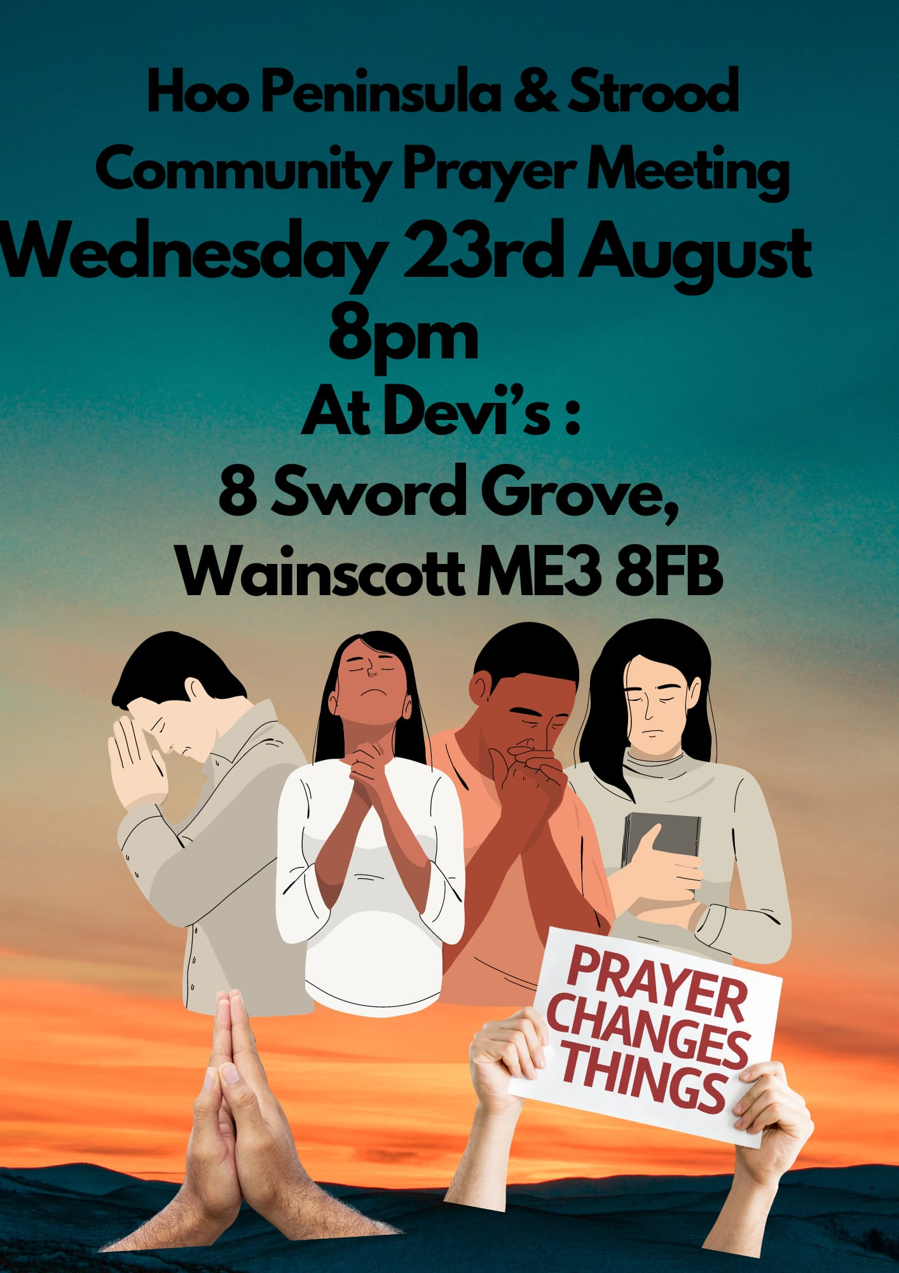

Slide 38


Slide 39


Slide 40


Slide 41
Amen!

